Slide 1

NYU Cyber Fellows
CS GY 6573
Penetration Testing
Web Application Testing
©2021 NYU Tandon School of Engineering

Slide 2
Web App Testing
This lab will allow you to practice some of the tools and techniques used to test the security of websites
You will configure a proxy and use other techniques to do some tests against a target
You will try out different types of exploits and see how they apply to different vulnerabilities

Slide 3
Target
This lab has two options
You can follow this lab's instructions and try doing it with a live target
You can instead use Metasploitable and DVWA
Option A: indeed.com
We had previously done some recon against indeed.com
We will pick up where we left off and try some more recon and setting up some of the tools mentioned
Might be worth it! Previous semesters, certain students found vulnerabilities and earned monetary bounties from Indeed
If you go with option B: Metasploitable V2
This runs a vulnerable application...a damn vulnerable one!
Damn Vulnerable Web Application (DVWA) (https://dvwa.co.uk/)
Either way, we will switch to Metasploitable in later labs when we are attacking, brute forcing, and automated scanning

Slide 4
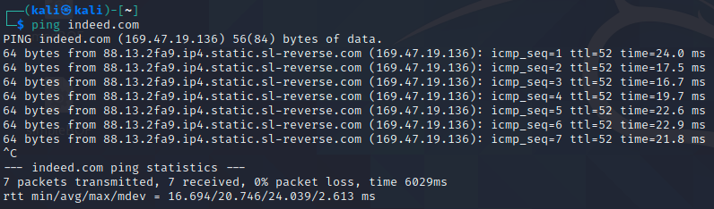




Option A - Networking
All we need to do is make sure Kali can hit the internet
You can use NAT or bridged, should be no impact
Ping indeed.com to test
Kali
<your IP>
*.indeed.com/*
Internet

Slide 5
Option B - Metasploitable
Metasploitable is an Ubuntu distribution released by Rapid7
Its purpose is to be vulnerable and let us practice!
Direct Download:
http://downloads.metasploit.com/data/metasploitable/metasploitable-linux-2.0.0.zip
Or sourceforge mirrors:
https://sourceforge.net/projects/metasploitable/
Metasploitable has been around for years and is well documented
Troubleshooting should be easy. If any issues completing anything in this lab, research first, then ask questions

Slide 6
Setup
We will use our Kali VM and the Metasploitable VM
The VMs must be networked
You can use host-only, bridged, internal, or NAT
You will not need internet access
Any IP addressing will work, as long as they can communicate
Test by pinging Metasploitable from Kali
Screenshots and solutions will show IP addresses below:
Networking
Kali: 10.10.0.10
Metasploitable: 10.10.0.20
Netmask: 255.255.255.0
Metasploitable
10.10.0.20
Kali
10.10.0.10

Slide 7
WARNING
Make sure that metasploitable is not exposed to an untrusted network!

Slide 8

Burp Suite
Configuration

Slide 9
Burp Suite
Burp Suite, by PortSwigger
A proxy and spider tool
Great for web app testing
We will
Configure to use it as a proxy
Manually spider some pages with indeed.com
Inspect the HTTP requests

Slide 10
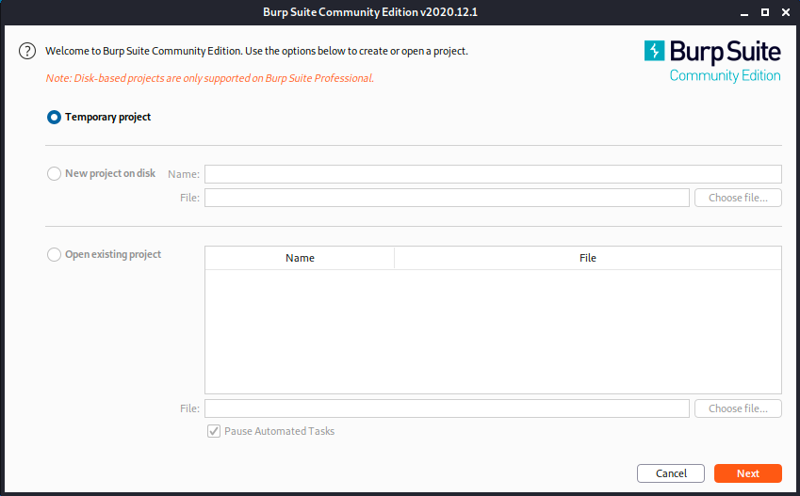
Start Burp
Start Burp in Kali, review any agreements, dismiss update notifications, and start a temp project with defaults
Update
$ sudo apt-get update
$ sudo apt-get install burpsuite
Then run
$ sudo burpsuite &
Note: Burp recommends 8 GB of RAM. If you can spare it, try to assign at least 4GB to Kali

Slide 11
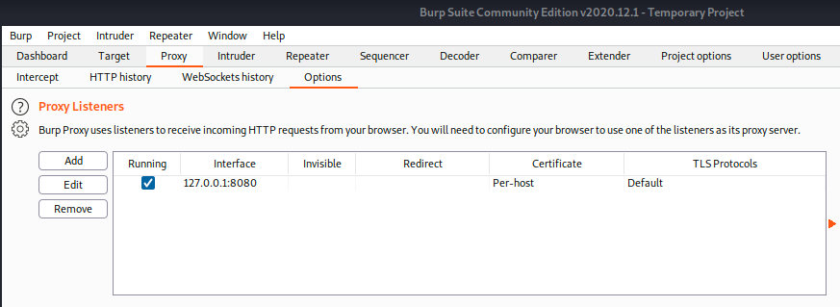
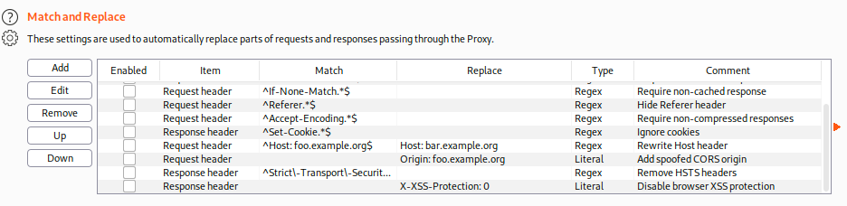
Burp Proxy
Once it starts up, navigate to proxy settings
Disable Intercept
Scroll down and look at some of the options
Even free version allows us to automatically do Match & Replace on web traffic

Slide 12
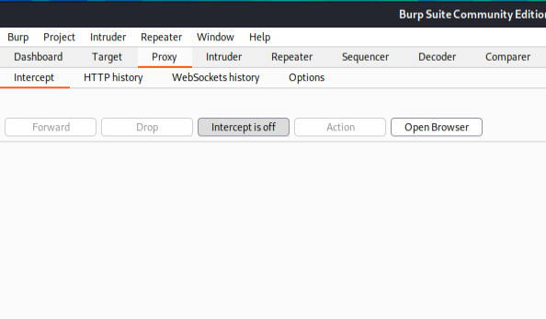
Disable

Slide 13
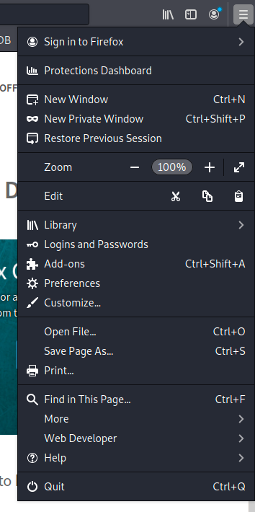
Configure your Browser
With your proxy running (it started by default), configure your browser in Kali to use burp!
Start your browser
We will use firefox in the lab
$ firefox &
Go to your preferences

Slide 14
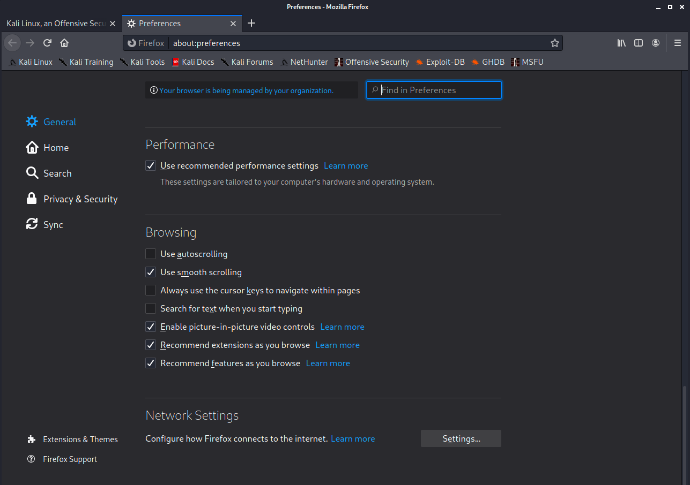
Proxy Configuration in Browser

Slide 15
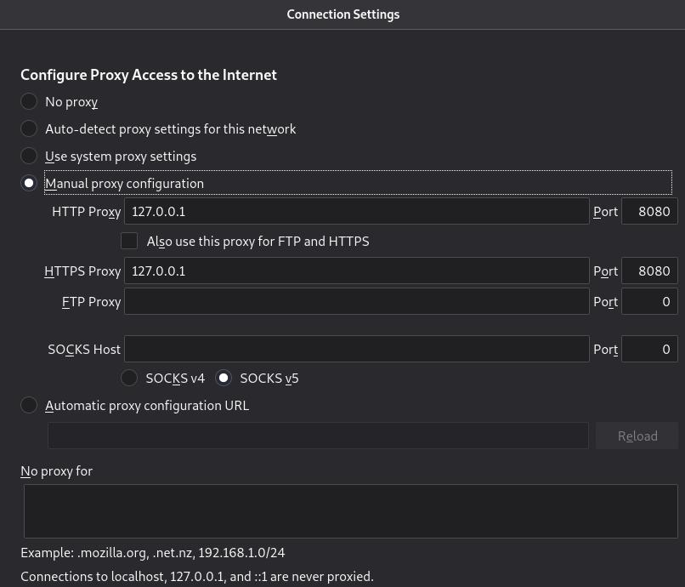
Proxy Configuration in Browser

Slide 16
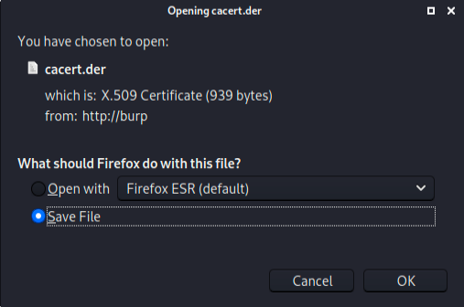
Install the Burp Certificate
If your proxy is working, you will be able to access http://burp/cert in your browser
Save file
Install the certificate
Complete walkthrough:
https://portswigger.net/burp/documentation/desktop/getting-started/proxy-setup/certificate/firefox

Slide 17
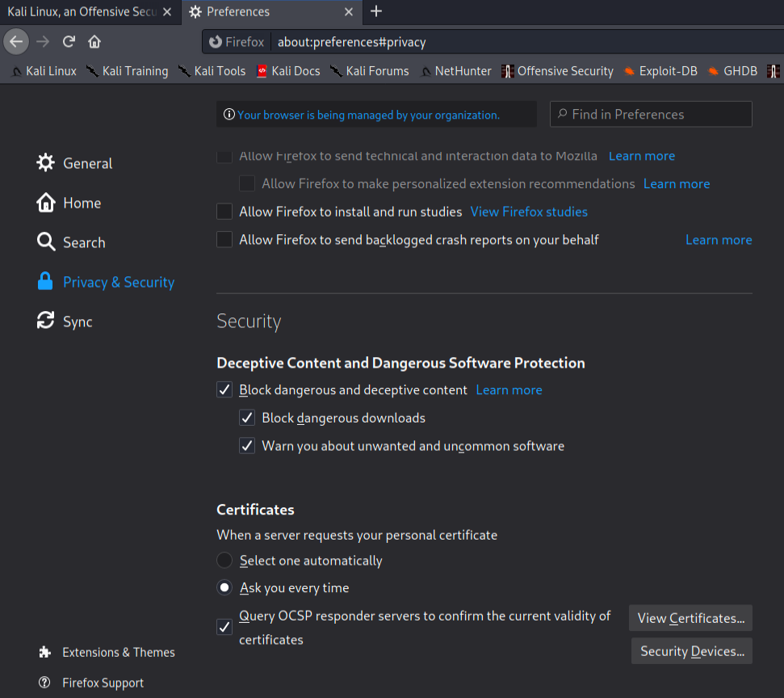
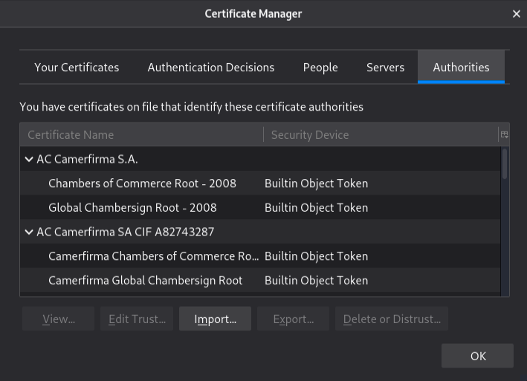
Install the Burp Certificate
Install certificate
Go to preferences

Slide 18
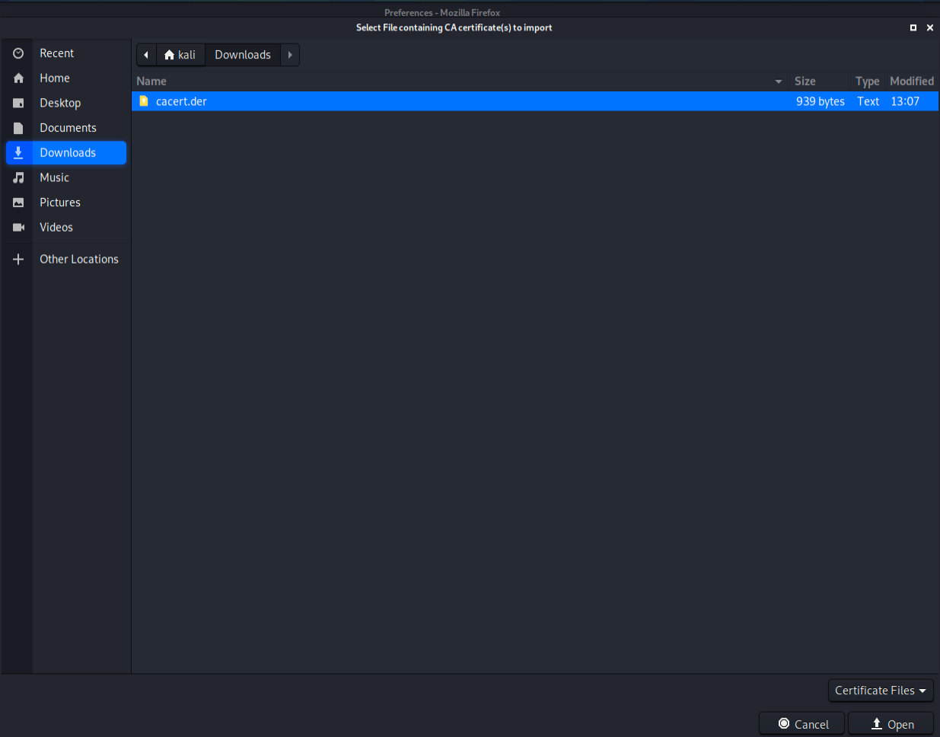
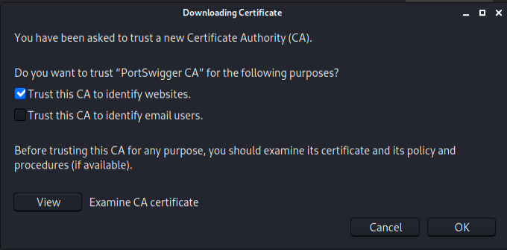
Install the Burp Certificate
Trust CA

Slide 19
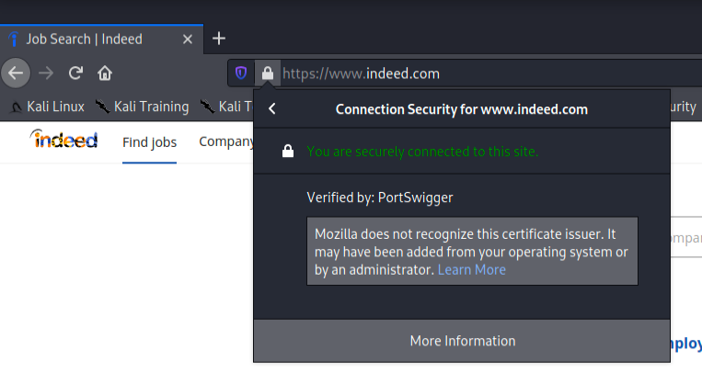




Option A - Test it
Go to indeed.com and view the certificate – should have no error
Green lock “Secure Connection”
Verified by: PortSwigger
Burp is now a Man in the Middle!
Web Server
Internet

Slide 20
Option B - Test it
Go to your Metasploitable IP address and browse around
For the rest of this section on Burp, if you are doing Option B (Metasploitable), just replace indeed.com with the IP address of Metasploitable

Slide 21
Phew!
Good and Bad: Gone are the days that we could browse the web while ignoring certificate errors
HSTS - HTTPS Strict Transport Security
"Unless you are using TLS properly, you cannot browse this website"
Along with HTTPS-everywhere, most sites also implement HSTS
We cannot ignore certificate errors
We do not even have the option of trusting a self-signed certificate
This can be solved by installing a new CA - what we just did
Difficult to do on mobile unless we have rooted the device
Remember, we still cannot use Burp to MitM traffic for mobile apps since they also use Certificate Pinning!
We would need to do extra steps, rooting the device and messing with the OS

Slide 22
Burp Suite
Testing

Slide 23
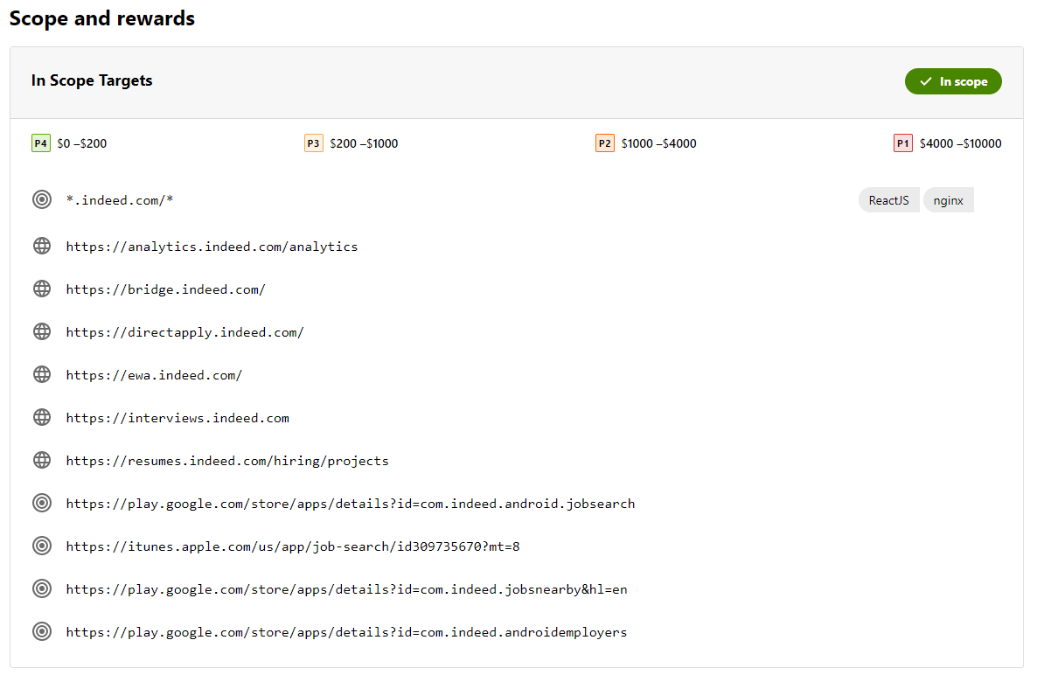
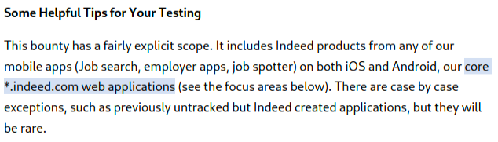
Option A Only - Review Scope from indeed
Take a moment and read the scoping document for Indeed
Understand it, abide by it
https://bugcrowd.com/indeed
This should be the 2nd time you have read this, but can always change!

Slide 24
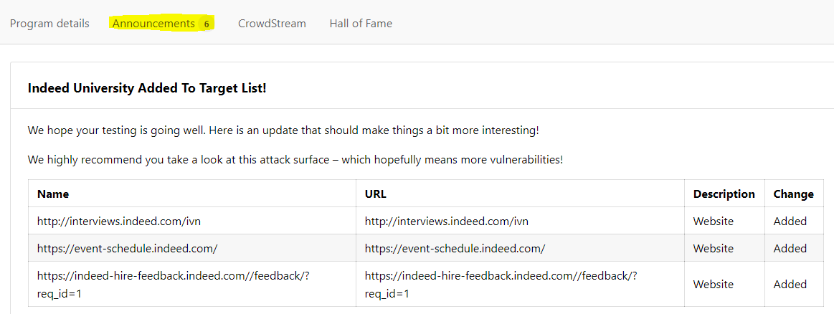
Target Update – Last update Dec 2020
Organizations and their bounty programs are constantly changing
Make sure you pay attention to the scope and targets
They might even change during your assessment

Slide 25
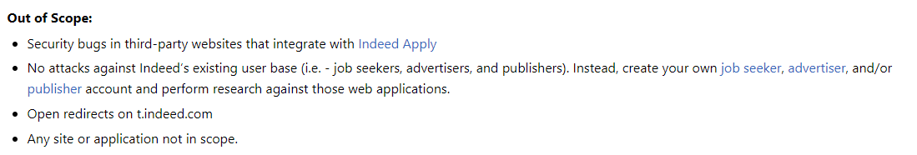
Indeed - Rules and Scope
Indeed - Rules and Scope
Read

Slide 26
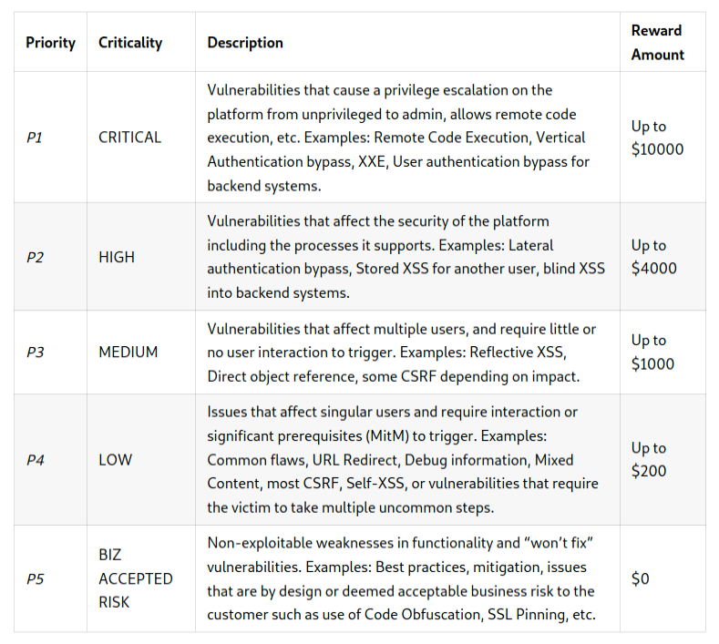
Vulnerability Criticality Ranking

Slide 27
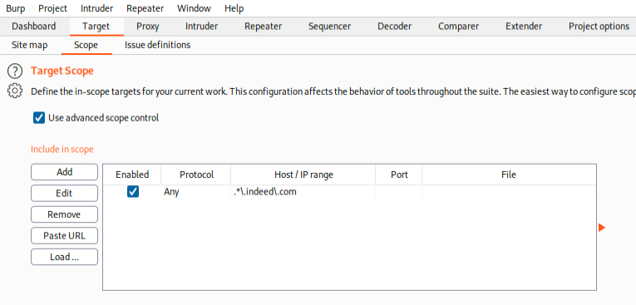
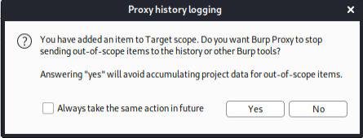
Configure Target
Make sure that we remain in scope - configure it in Burp
Set your scope to indeed.com and all subdomains, you must use regex
.*\.indeed\.com
. matches any character
* means repeated 0 or more times
\ escapes special characters (. is special)
Select "Yes" to only save stuff in-scope

Slide 28
Passive Crawler
Burp Community edition does not have access to certain Pro features such as Spider and automated scanner
There is also significant throttling if we use intruder or repeater
We can still do a lot using manual methods though
One feature we will look at next is the Crawler

Slide 29
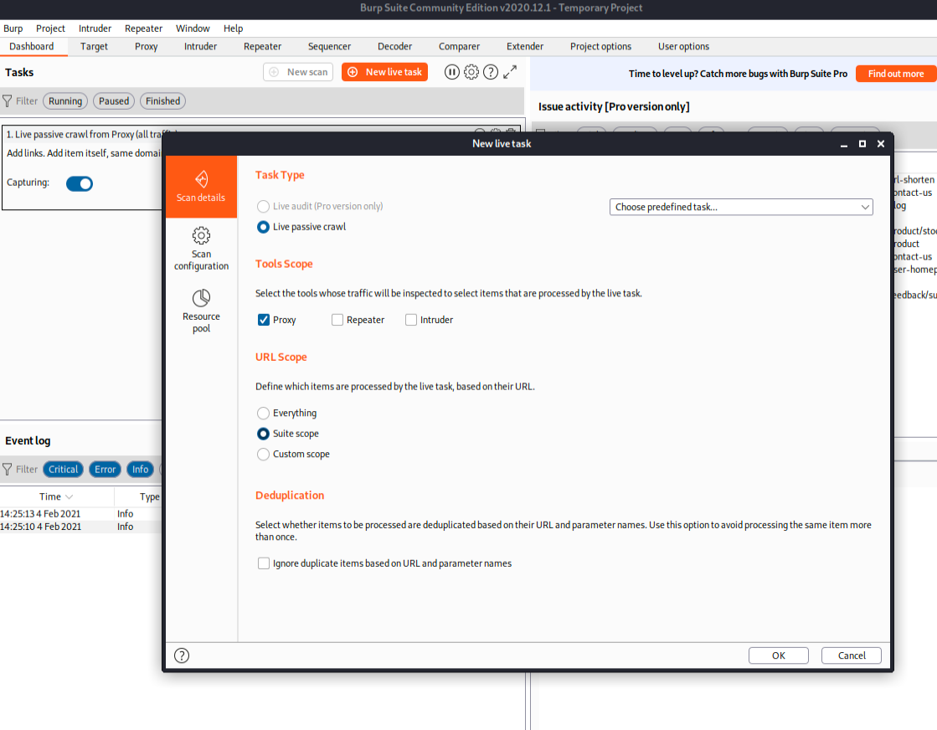
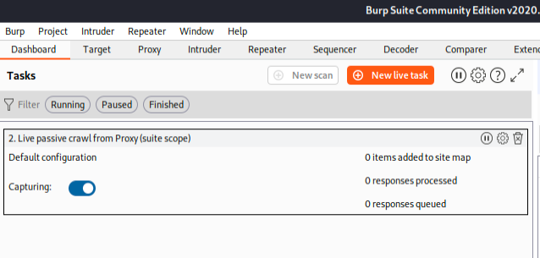
Passive Crawler
Start a New Live Task to inspect Proxy Traffic within the Suite Scope
Make sure only one task is capturing – our in-scope crawler

Slide 30
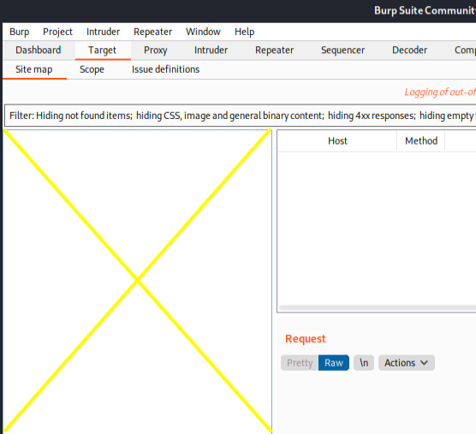
Clear Old Traffic
Go to the Target tab
Ctrl-A and right click
Delete Selected Items
With a clean screen (see right), visit indeed.com
We should start to see all the pages Burp passively records as we browse

Slide 31
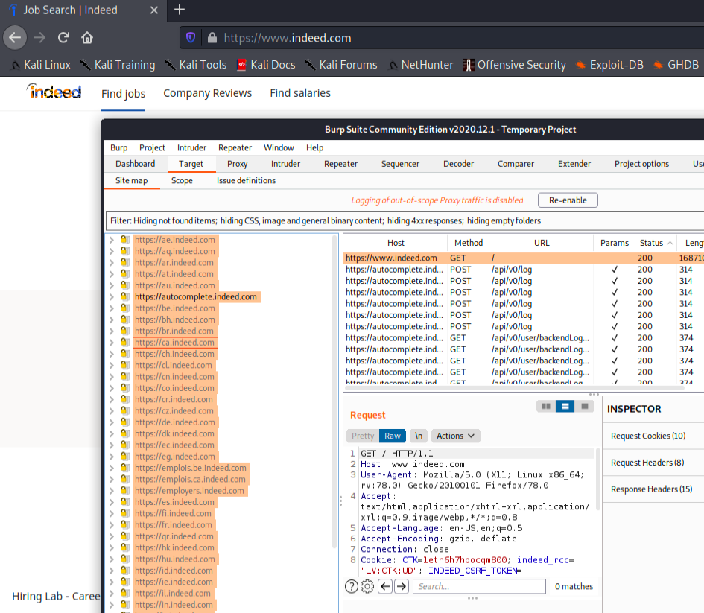
Passive Spider

Slide 32
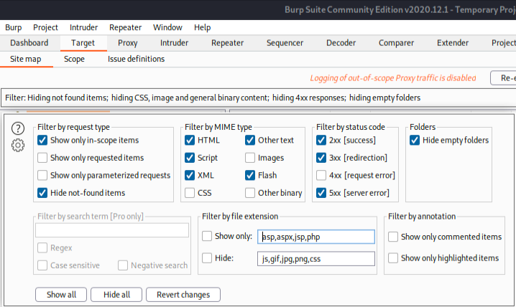
Filter
Filter out things outside of scope
Make sure everything remaining are actually targets that are in scope!

Slide 33
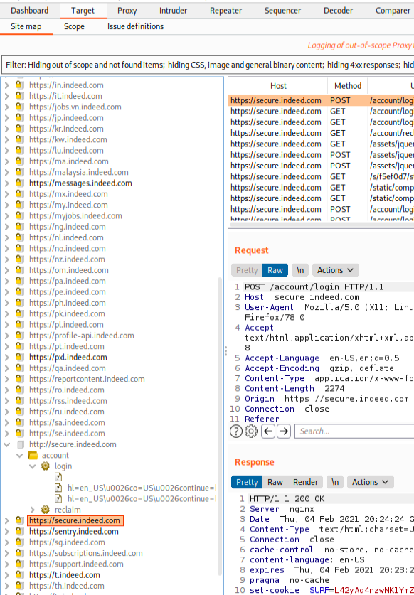
Identify pages that accept user input
Passively browse+crawl in Firefox and see the pages show up in Burp
Try to find some pages that could be used to test
Anything that takes user input
Forms, Cookies, Tokens

Slide 34
In scope - Test for a vulnerability manually
Using an interesting page or domain which you may have previously found, try testing for a vulnerability
Do this manually in your browser, do not use any automated tools
Try different types of input
Escape characters
Look at the source
Follow what you do in Burp
In the Proxy tab
What should you target or try?
Start with our methodology steps – Enumerate and Recon – Find something interesting, research if possible, and verify that it is worth testing
If you find something, report it to indeed!

Slide 35
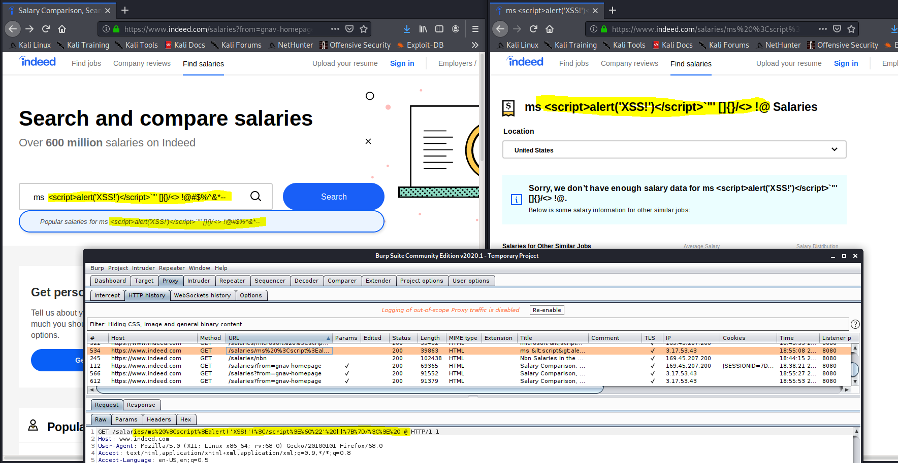
Example
Make at least one attempt at a manual test for security controls
Example below: Testing for XSS injection when user input is reflected back
Interesting test, our input is getting truncated in the request. What if we manually request it?

Slide 36
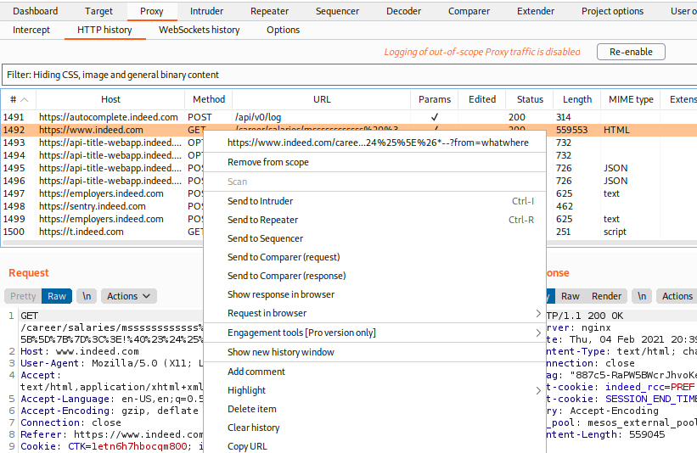
Example
Find the request of interest, right click, send to repeater

Slide 37
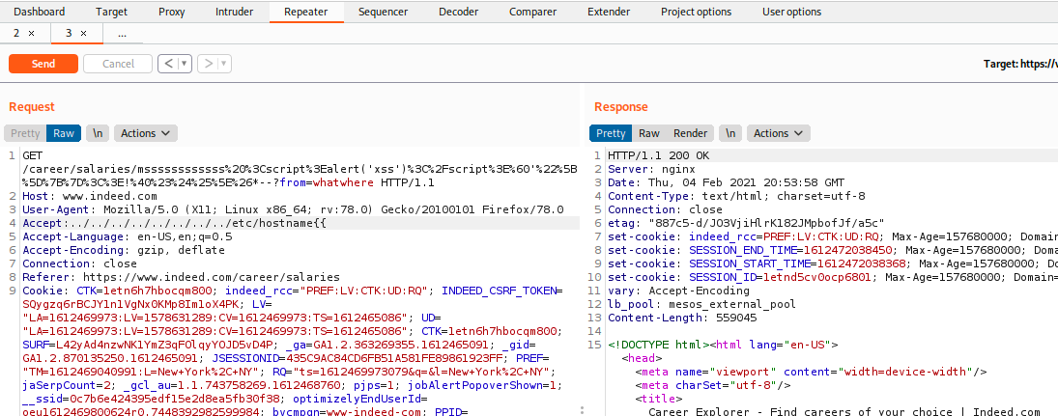
Example
In Repeater, we can change the request, resend, and compare the results
Looking for strange behavior, errors, anything that may be an indicator the server did something unexpected or unintentional
Try fuzzing a few parameters to trigger some unintentional or unexpected responses

